Slide 1
An Introduction to Database
Introduction to Database for Undergraduate Study
Lecture 7
Arithmetic in Columns
Column Alias
String Concatenation
This lecture and its associated materials have been produced by Mr. Rohit Panday (M.Sc. IT, 10+ Years of Industry/Academic Experience) of iAcademy for the purposes of lecturing on the above described subject and the material should be viewed in this context. The work does not constitute professional advice and no warranties are made regarding the information presented. The Author and iAcademy do not accept any liability for the consequences of any action taken as a result of the work or any recommendations made or inferred. Permission to use any of these materials must be first granted by iAcademy.

Slide 2
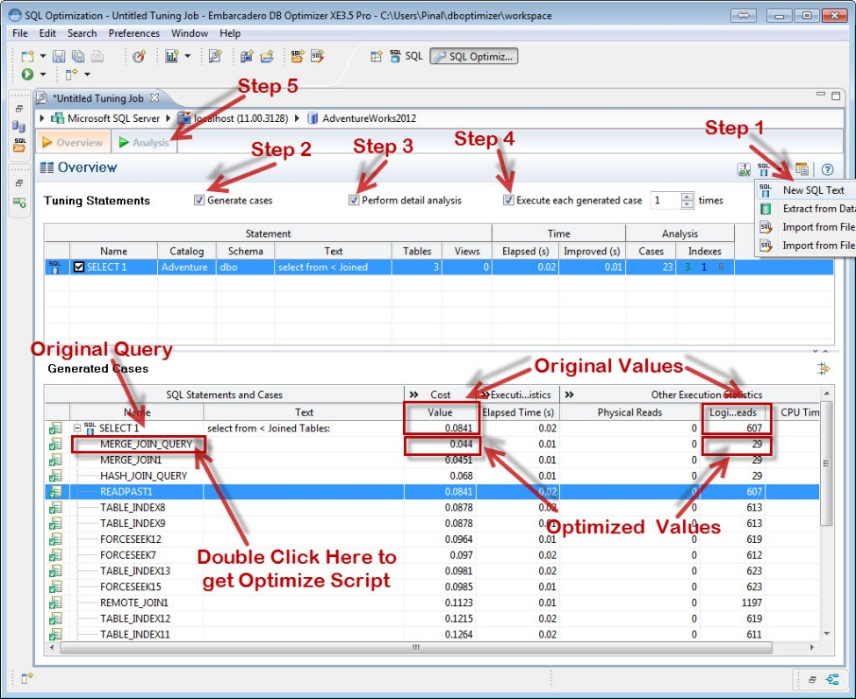
ADVANCED SQL
SQL implements various other features to carry out actual business processes

Slide 3
Arithmetic in Columns
An expression is a combination of one or more values, operators, and SQL functions that evaluate to a value.
SQL EXPRESSIONs are like formulas and they are written in query language. You can also use them to query the database for specific set of data.
Also understood as Calculated Columns or Derived Columns or Expressions

Slide 4
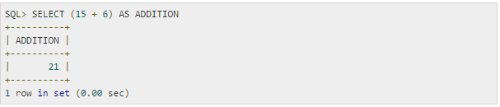
Numeric Expressions
Example | SELECT numerical_expression as OPERATION_NAME [FROM table_name WHERE CONDITION] ;
Result

Slide 5
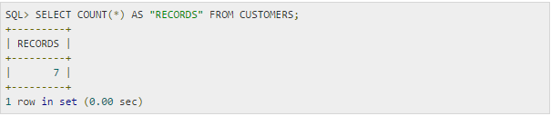
Numeric Expressions
Example | SELECT numerical_expression as OPERATION_NAME [FROM table_name WHERE CONDITION] ;
Result

Slide 6
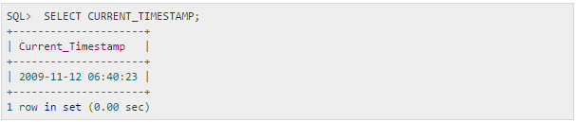
Numeric Expressions
Example | SELECT numerical_expression as OPERATION_NAME [FROM table_name WHERE CONDITION] ;
Result

Slide 7


Calculating Column Values
Example | SELECT name, monthly_salary*12 as Annual_Salary [FROM staffs WHERE CONDITION] ;
Result
SELECT id, value, (value/2) AS calculated FROM mytable;

Slide 8
Calculating Column Values
Example | CREATE TABLE order_details (price DOUBLE, quantity INT, amount DOUBLE AS (price * quantity));
Result | INSERT INTO order_details (price, quantity) VALUES(100,1),(300,4),(60,8);
Can be even used during TABLE CREATION

Slide 9
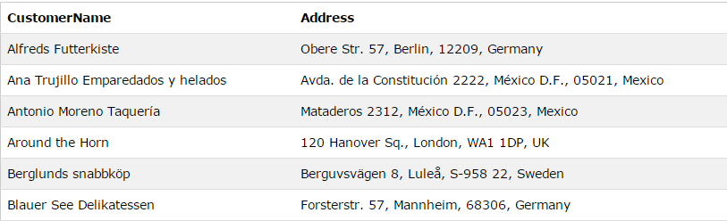
Concatenation
Example | SELECT CustomerName, CONCAT(Address,', ',City,', ',PostalCode,', ',Country) AS Address FROM Customers;
Result

Slide 10
Other Advanced Features
ORDER BY Clauses
DISTINCT Clause
NULL value

Slide 11
ORDER BY
Example | SELECT column_name, column_name FROM table_name ORDER BY column_name ASC|DESC, column_name ASC|DESC;
Result

Slide 12
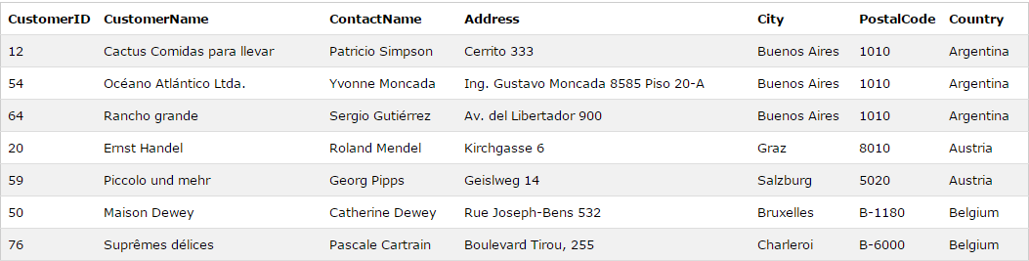
ORDER BY
Example | SELECT * FROM Customers ORDER BY Country;
Result

Slide 13
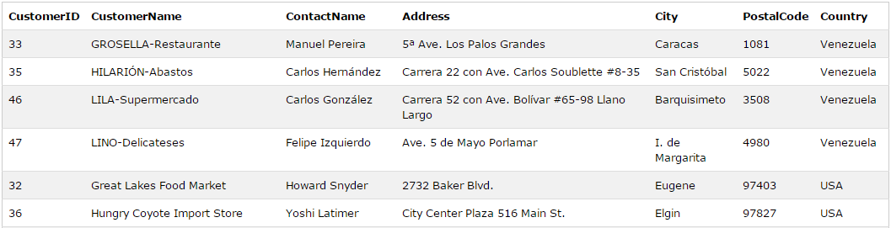
ORDER BY
Example | SELECT * FROM Customers ORDER BY Country DESC;
Result

Slide 14
DISTINCT
The SELECT DISTINCT statement is used to return only distinct (different) values.
SELECT DISTINCT column_name, column_name
FROM table_name;

Slide 15
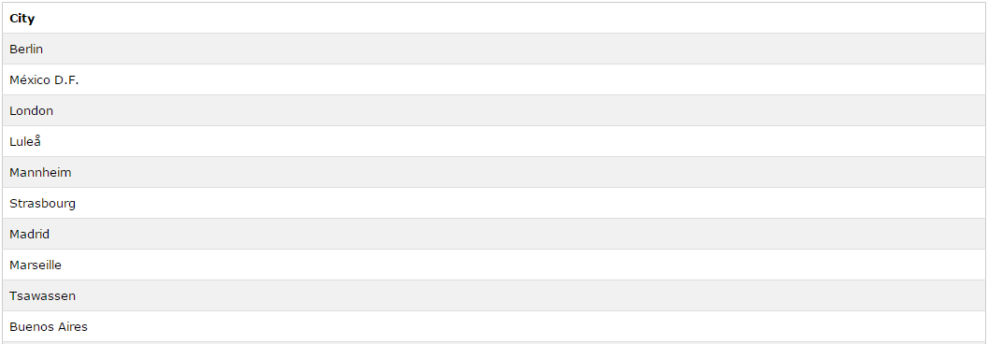
DISTINCT
Example | SELECT DISTINCT City FROM Customers;
Result

Slide 16
NULL Values
If a column in a table is optional, we can insert a new record or update an existing record without adding a value to this column. This means that the field will be saved with a NULL value.
NULL values are treated differently from other values.
NULL is used as a placeholder for unknown or inapplicable values.
NULL values represent missing unknown data.

Slide 17
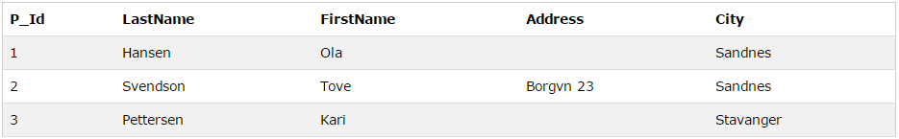
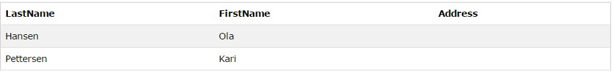
NULL
Example | SELECT LastName,FirstName,Address FROM Persons WHERE Address IS NULL
Result

Slide 18
VIEW
In SQL, a view is a virtual table based on the result-set of an SQL statement.
A view contains rows and columns, just like a real table. The fields in a view are fields from one or more real tables in the database.
You can add SQL functions, WHERE, and JOIN statements to a view and present the data as if the data were coming from one single table.
A view is a virtual table.

Slide 19

VIEW
Example | CREATE VIEW view_name AS SELECT column_name(s) FROM table_name WHERE condition
Result

Slide 20
Constraints
Primary Key
Foreign Key
Check

Slide 21
Functions
AVG()
LEN()
COUNT()
Returns the average value of numeric column
SELECT AVG(column_name) FROM table_name
returns the length of the value in a text field.
SELECT LEN(column_name) FROM table_name;
returns the number of rows that matches a specified criteria.
SELECT COUNT(column_name) FROM table_name;

Slide 22
Key Points

Slide 23

Laugh

Slide 24

End of Lecture for Week - 7

